Slide 1
Implementation of HiGOC Framework
Srinivasan Kidambi || Justin Rangad

Slide 2
Table of contents
01
02
03
04
05
06
Framework
Midterm Progress
Current Architecture
Training Plots, Table, Maps and Videos
Improvement
Conclusion

Slide 3
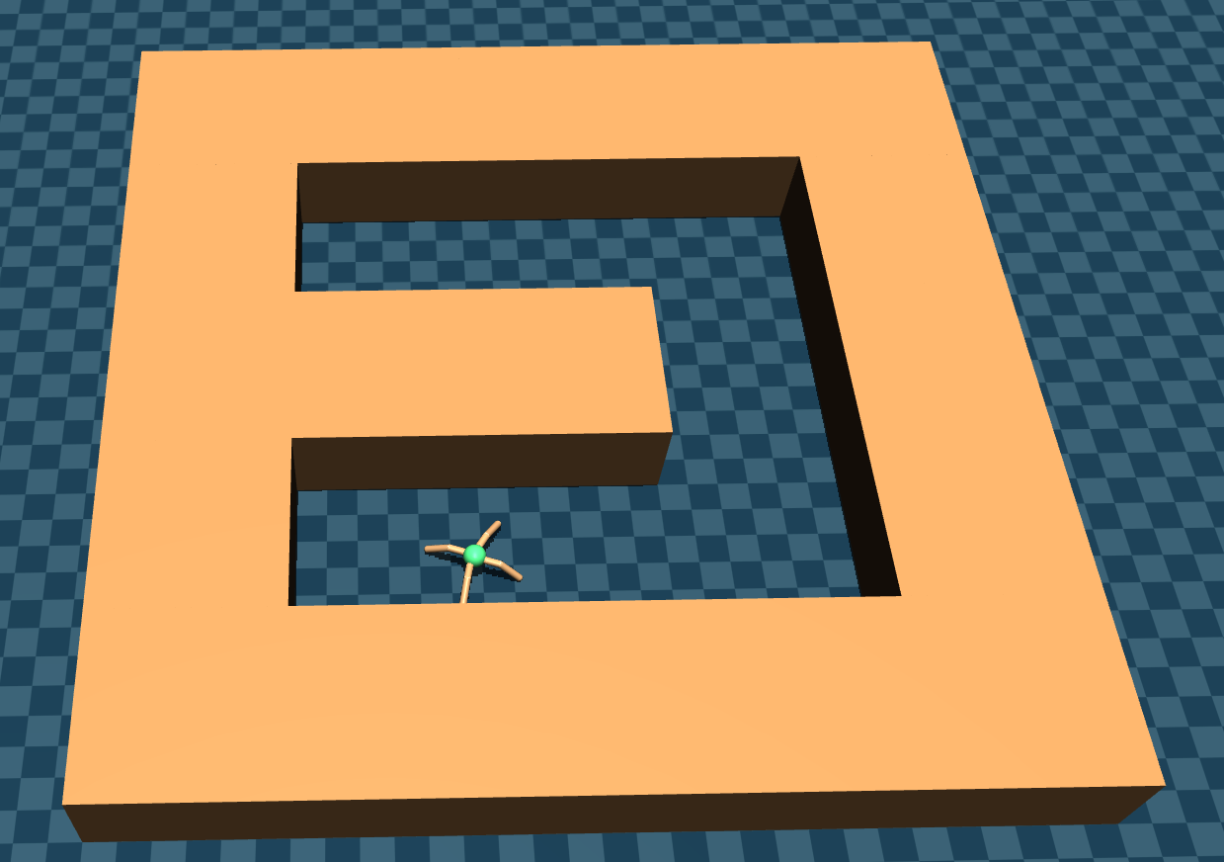
01
Framework

Slide 4
The Paper
Problems with Offline RL
The Solution
Extended Temporal Exploration is often a hindrance to training
Distribution shift is a recurring issue in offline RL training
Plan subgoals along the trajectory
Condition policy and value function to reach subgoals
This gives us a 2 layer framework

Slide 5
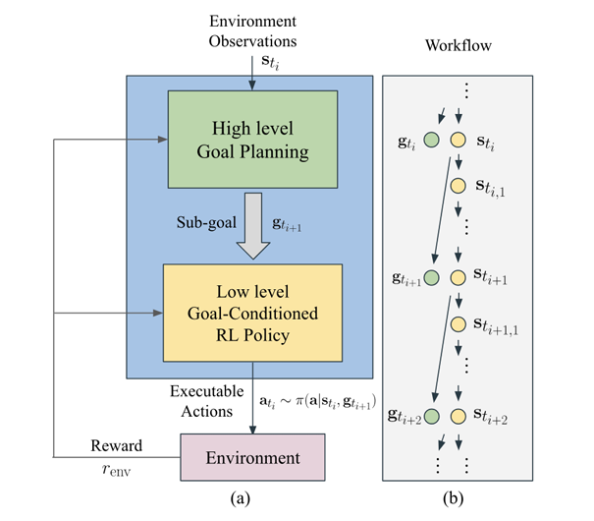

The Paper
High Level Planner
Uses a CVAE to model latent state space
Planning in the latent space using CEM optimization
Maximize value over subgoals
Penalize low probability states

Slide 6
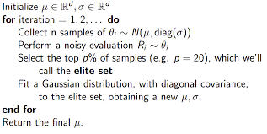
The Paper
High Level Planner
Optimization using CEM method
This is a non gradient approach, iteratively optimizes the objective

Slide 7
The Paper
Low Level Agent
Policy + Value Function conditioned on subgoals
Paper uses CQL-SAC for low level agent
The value from the low level agent is used in the high level subgoal planning

Slide 8


The Paper
Low Level Agent
While training the low level agent, goals are drawn from trained CVAE with added noise to promote OOD robustness.
Rewards are re-labelled to penalize OOD goal following
Relabelled Reward

Slide 9
02
Midterm Progress

Slide 10
Progress as of midterm
CVAE coding
CQL-SAC agent
Problem identification
Set up the latent space encoder and tested it on the Taxi environment.
We had implemented CQL-SAC and got it to work in the Taxi environment independent of the high level planner
We realised that some changes were possible to better the model’s performance
Specifically, we hoped to improve offline RL learning methodology

Slide 11
03
Current Architecture

Slide 12
Low Level Agent
IQL
TD3+BC
Offline Learning Methodology

Slide 13
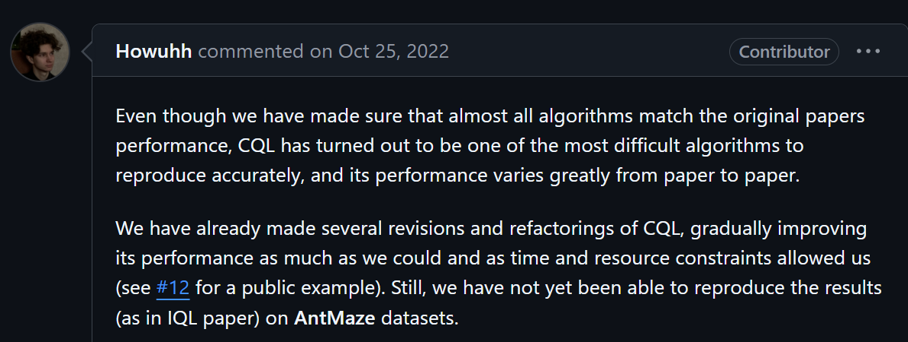
Why not CQL?

Slide 14
Why not CQL?
Original CQL implementation did not converge on antmaze tasks
Author recommended implementation used tricks to achieve convergence, but we were unsure of how that would affect the HiGOC implementation
Therefore, we decided to modify our evaluation paradigm since the goal was to show effectiveness of the high level planning

Slide 15
Why IQL Why TD3 + BC
Faster convergence => easier to train with limited resources
Better performance than CQL+SAC on most antmaze tasks
Verified and reproducible performance on benchmarks with hyperparameter choices
While IQL is good on most tasks, it underperforms on Umaze-Diverse
This makes it tough to see the effectiveness of high level planning on this environment
Method | IQL | TD3+BC
Umaze | 87.5 | 78.6
Umaze-Diverse | 62.2 | 71.4

Slide 16
04
Training Plots, Table, Maps and Videos

Slide 17
Experiment Setup
Training of each model for 40k timesteps
Weight of distance penalty in reward fixed at 0.01
On each environment ->
For each low level agent ->
For each of 5 seeds ->
Average score across 5 episodes
Average score across 5 seeds

Slide 18
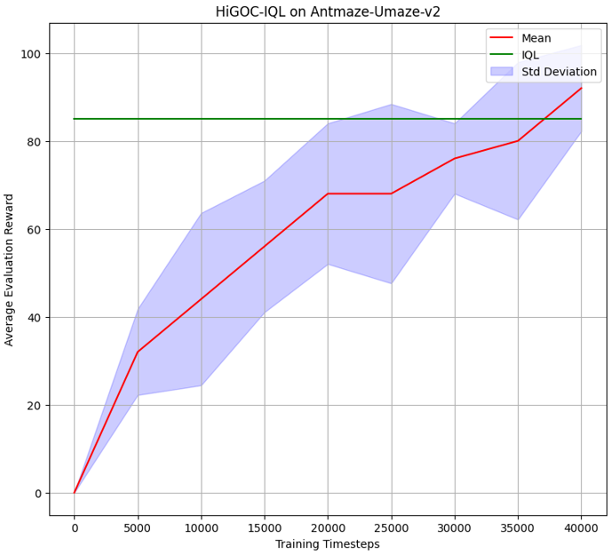
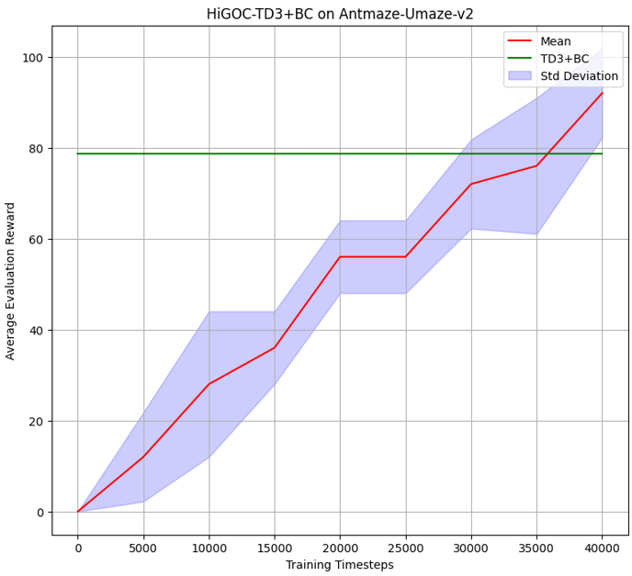
Plots on Umaze-v2
We see that IQL based HiGOC and TD3+BC converge on this environment to good scores.
Both outperform their respective low level policies

Slide 19


Videos on Umaze-v2
s
HiGOC-IQL
HiGOC-TD3+BC

Slide 20
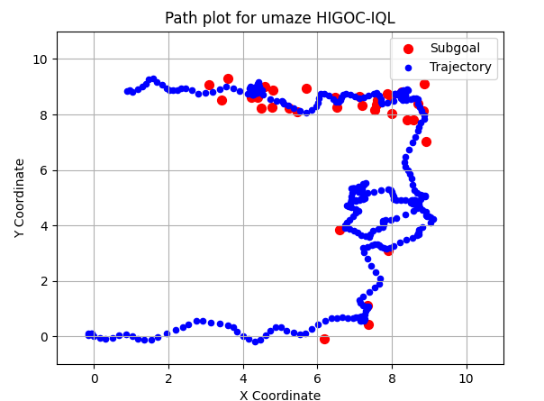
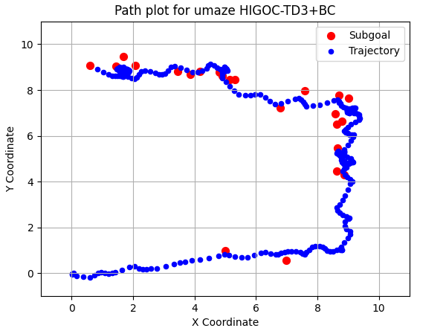
Maps on Umaze-v2

Slide 21
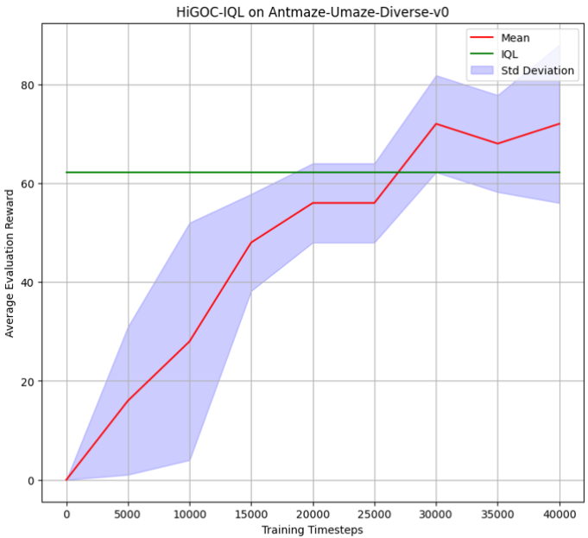
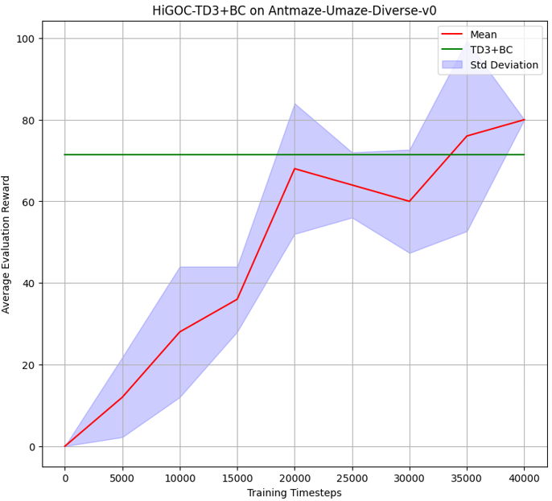
Plots on Umaze-Diverse-v0
We see that IQL based HiGOC and TD3+BC converge again.
Both outperform their respective low level policies as well, HiGOC-IQL especially

Slide 22


Videos on Umaze-diverse-v0
HiGOC-IQL
HiGOC-TD3+BC

Slide 23
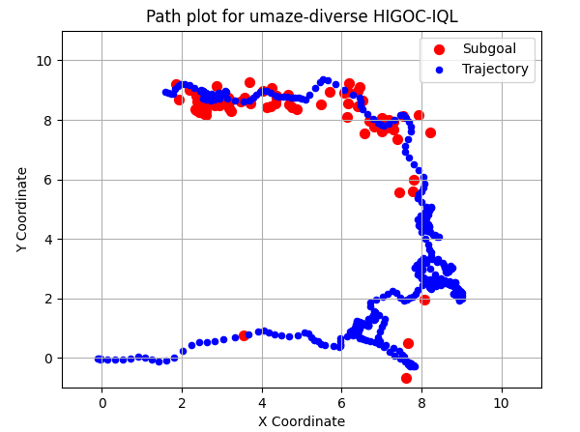
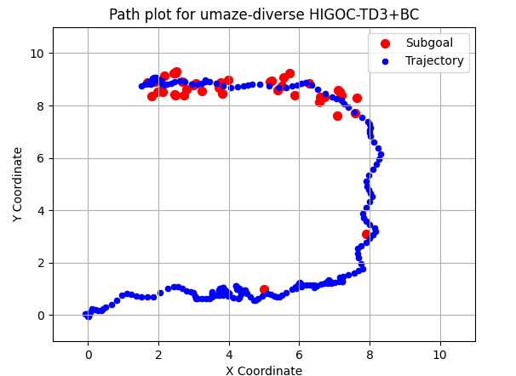
Maps on Umaze-diverse-v0

Slide 24
Low Level Agent vs HiGOC Table
Environment | IQL | HiGOC-IQL | TD3+BC | HiGOC-TD3+BC
Umaze-v2 | 87.5 | 88 | 78.6 | 88
Umaze-Diverse-v0 | 62.2 | 72 | 71.4 | 80

Slide 25
05
Improvement

Slide 26
Improvements to the High Level Planner
Motivation
The Solution
There are too many plans in any one episode
Too much time per episode lost in planning
Too much subgoal density towards the end
Decreased number of subgoals per plan, reduce one each new plan.
Add weighted distance between subgoal and true goal to value => influences subgoal choice in CEM.

Slide 27

Experiment Setup
The model was not re-trained, we use the original trained HiGOC-IQL model since our proposal is a change to only the high level planner.
Weight of distance in updated value of a subgoal was set at 0.1
On each environment ->
For each low level agent ->
For each of 5 seeds ->
Average score across 5 runs of 5 episodes
Average score across 5 seeds

Slide 28
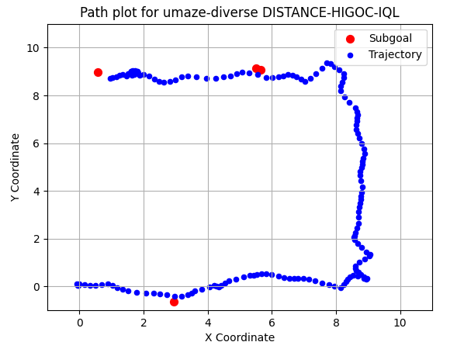

Distance HiGOC-IQL Performance

Slide 29
Improved Planner vs HiGOC Planner
Metric | Distance HiGOC-IQL | HiGOC-IQL
Score | 73.6 | 72
Runtime per episode | ~15 seconds | ~180 seconds

Slide 30
06
Conclusion

Slide 31
What we achieved in this project
Codebase for HiGOC
Effect of Low Level Agent
In this project, we have fully coded from scratch the HiGOC planner from the paper. This was a paper that does not have a codebase and we hope this will aid future work in goal conditioned RL.
We investigated the effect that the low level agent has on the performance of the entire model. We showed that the more effective the agent at learning the value and action space, the easier it is to get the model to converge.
Faster Planner
We also propose a modified high level planner at evaluation time, which runs significantly (more than 10 times) faster than the original from the paper and which also spreads out subgoals in sparse reward environments which helps the agent reach the goal faster.

Slide 32
Thank You !

